Slide 1

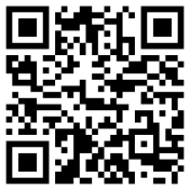

Introduction to regression models using R and Tidymodels
Join the chat at https://aka.ms/LearnLiveTV
Eric Wanjau
Follow along with these modules at https://aka.ms/learnlive-20220909A
Data Scientist and Researcher
Leeds Institute for Data Analytics University of Leeds
@ericntay
Karani Wachira
Undergrad student DeKUT R Community Lead
Dedan Kimathi University of Technology
@mrAfricanSeed
Notes:
GET EXCITED
High energy. Welcome the audience and each other to this Learn Live
Introduce yourselves.
Small amount of cross-talk.
Link to published modules on Learn:
https://docs.microsoft.com/en-us/learn/modules/plan-resource-requirements
https://docs.microsoft.com/en-us/learn/modules/configure-azure-cosmos-db-sql-api

Slide 2

Say hi to our moderator 👋!
Pascal Burume
Network and telecommunications engineer, Microsoft Student Ambassador
Youth Africa Technologies
LinkedIn: /in/pascal-burume-909520218/

Slide 3
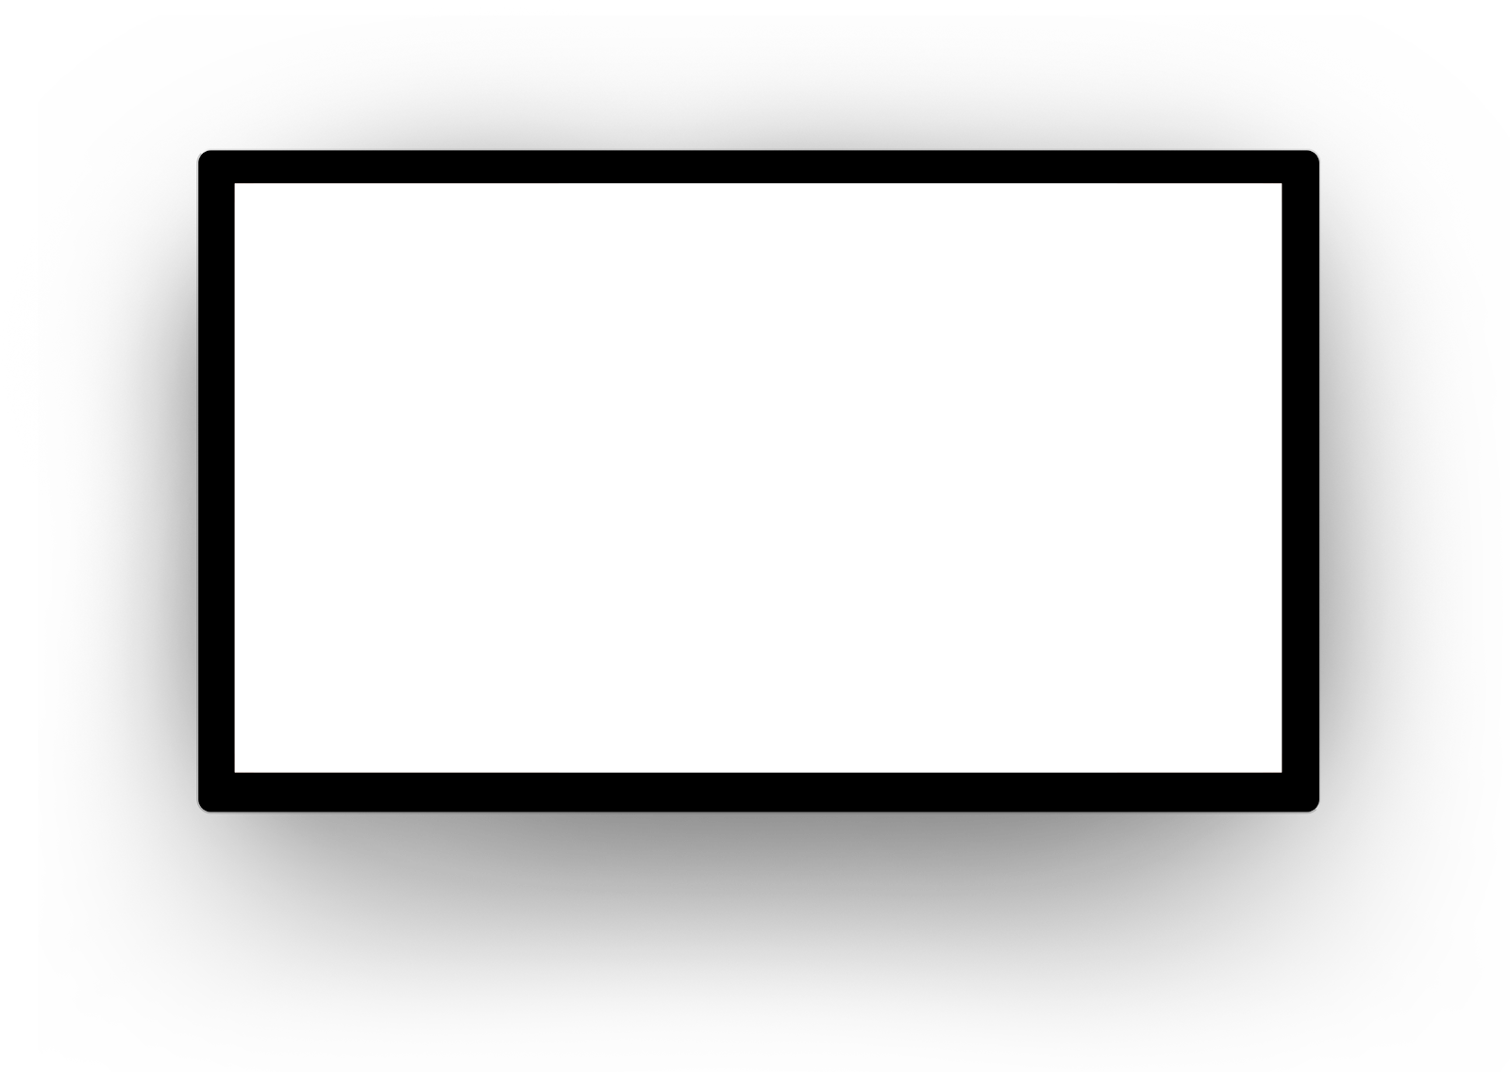
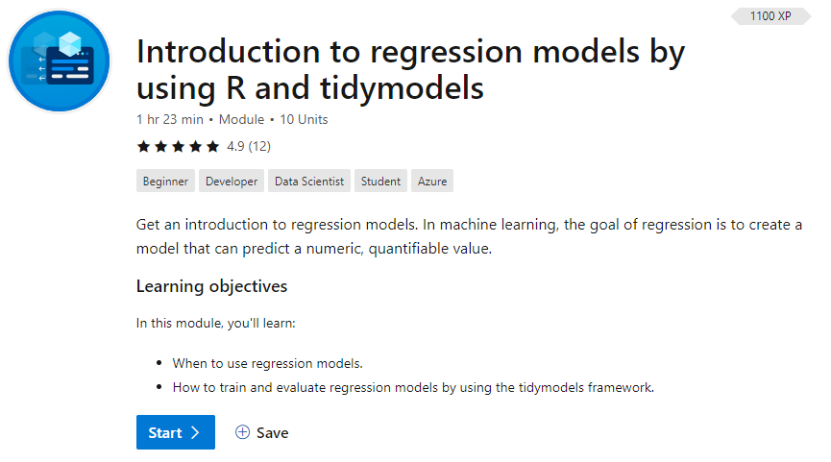
/learn
https://aka.ms/learnlive-20220909A
Complete interactive learning exercises, watch videos, and practice and apply your new skills.
Notes:
Introduce the module

Slide 4

Learning objectives
When to use regression models.
How to train and evaluate regression models by using the tidymodels framework.
Notes:
Our learning objectives for today are

Slide 5
What is regression?

Slide 6
What is regression?
Supervised ML technique that works by establishing a relationship between variables in the data to predict a numeric, quantifiable value.
A training dataset. You'll apply an algorithm that determines a function that encapsulates the relationship between the feature values and the known label values.
A validation or test dataset. You can use it to evaluate the model by using it to generate predictions for the label and comparing them to the actual known label values.
Notes:
Regression works by establishing a relationship between variables in the data. Characteristics of the thing being observed are known as the features. The variable you're trying to predict is known as the label.
Recall that your company rents bicycles and wants to predict the expected number of rentals in a day. In this example, features include the day of the week and month. The label is the number of bicycle rentals.
To train the model, you'll start with a data sample that contains the features and known values for the label. In this case, you need historical data that includes dates, weather conditions, and the number of bicycle rentals.
You'll then split this data sample into two subsets:
A training dataset. You'll apply an algorithm that determines a function that encapsulates the relationship between the feature values and the known label values.
A validation or test dataset. You can use it to evaluate the model by using it to generate predictions for the label and comparing them to the actual known label values.
The use of historic data with known label values to train a model makes regression an example of supervised machine learning.

Slide 7
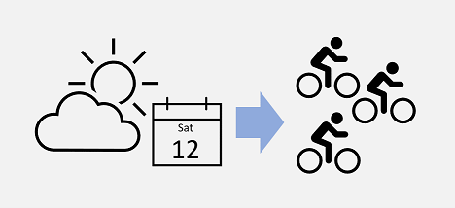
What is regression: Predicting bike rentals
Notes:
Regression is a technique that uses models to predict a number.
In machine learning, the goal of regression is to create a model that can predict a numeric, quantifiable value. This value can be a price, amount, size, or other scalar number.
Regression is a statistical technique of fundamental importance to science because of its ease of interpretation, robustness, and speed in calculation. Regression models provide an excellent foundation to understanding how more complex machine learning techniques work.
In real-world situations, particularly when little data is available, regression models are useful for making predictions. For example, if a company that rents bicycles wants to predict the expected number of rentals on a day in the future, a regression model can predict this number. The company can create a model by using existing data like the number of bicycles rented on days where the season and day of the week were also recorded.

Slide 8



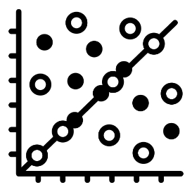

The plan: Predicting bike rentals
EDA
Data Budgeting
Fit and evaluate a linear regression model
Can we do better?
artwork by @allison_horst

Slide 9
/learn
https://aka.ms/learnlive-20220909A
Complete interactive learning exercises, watch videos, and practice and apply your new skills.
Notes:
Introduce the module

Slide 10

Knowledge Check

Slide 11

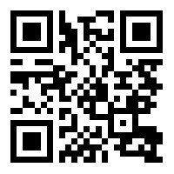
Question 1
The tidymodels framework was used in R to train a regression model from a dataset of sales data. To evaluate the model to ensure it will predict accurately with new data, what should be done?
Split the data randomly into two subsets. Use one subset to train the model and the other subset to evaluate it.
Use all the data to train the model. Then use all the data to evaluate it.
Train the model by using only the feature columns. Then evaluate it by using only the label column.
Vote at
Vote at https://aka.ms/polls
Notes:
Explanation: Correct. A common way to train and evaluate models is to hold back an evaluation dataset when training.

Slide 12
Can we do better?

Slide 13
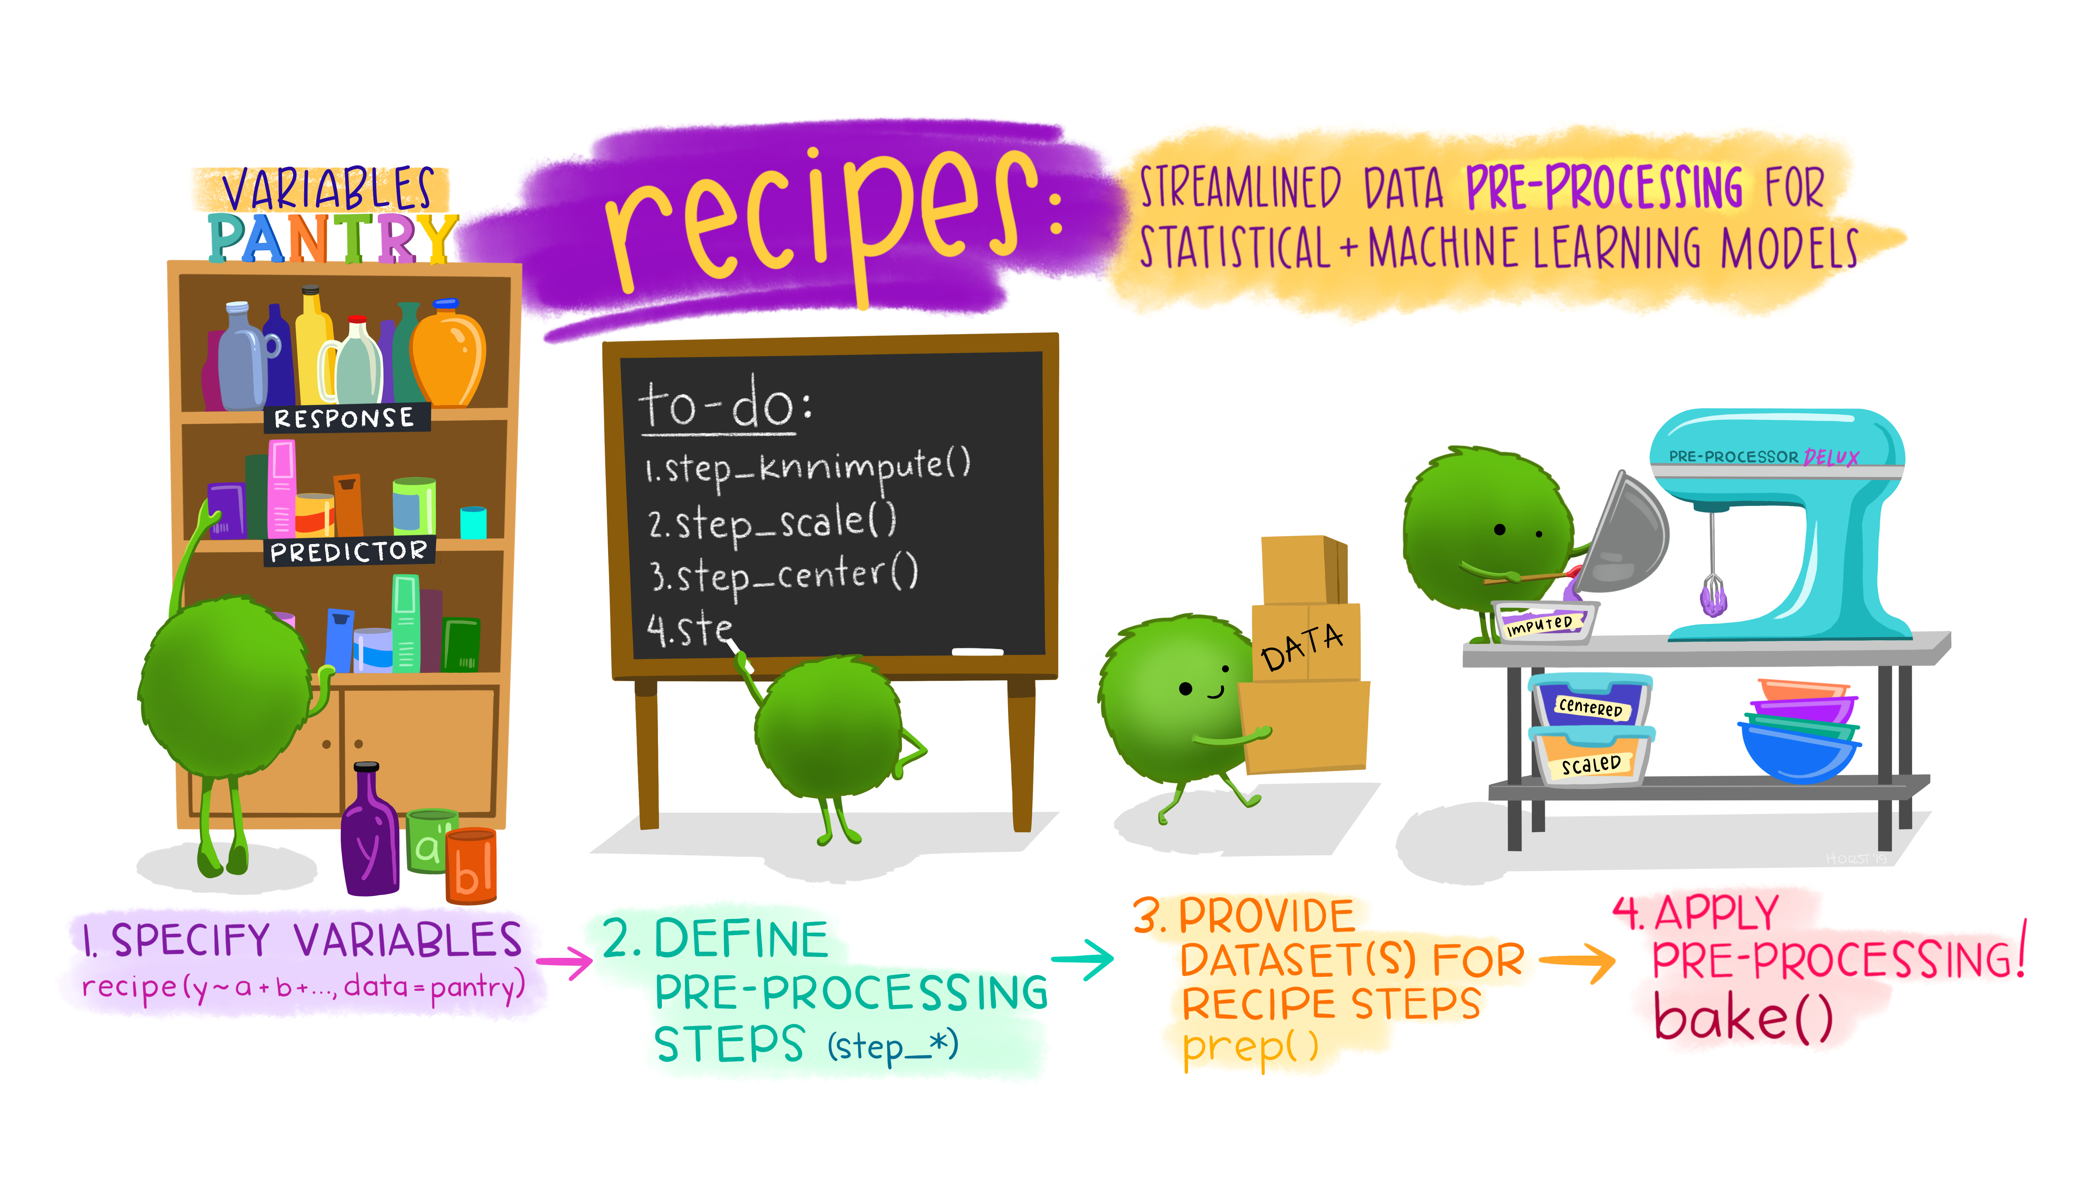
Feature Engineering with recipes
Normalize data
step_normalize()
Impute missing values
step_impute_mean()

Slide 14
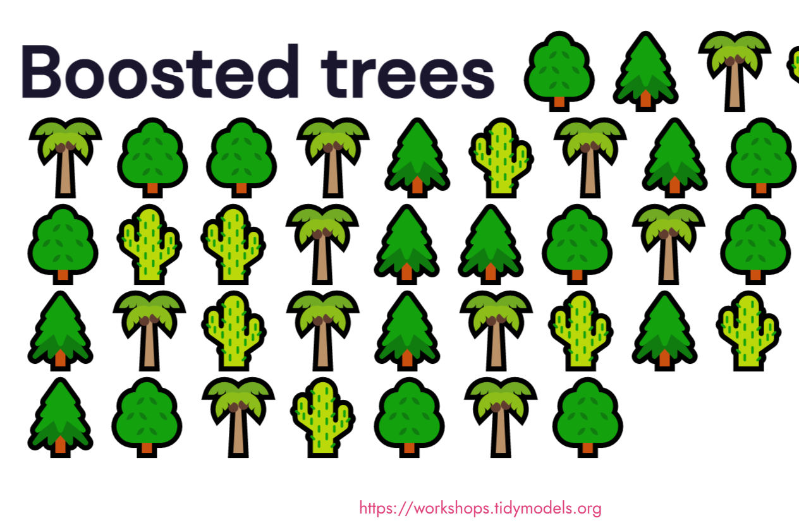
Try out a different model

Slide 15

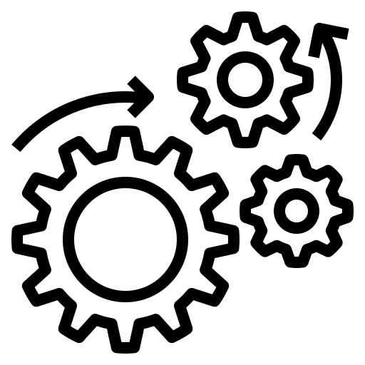

Model Tuning
Some model parameters cannot be estimated directly from the training data.
Instead of learning these kinds of hyperparameters during model training, we tune them
Try different values
Measure performance
Pick the best

Slide 16

Let's pause for a sec...
Typically we can’t decide on which final model to use with the test set before first assessing model performance.
There is a gap between our need to measure performance reliably and the data splits (training and testing) we have available
Tidy Modeling With R book

Slide 17
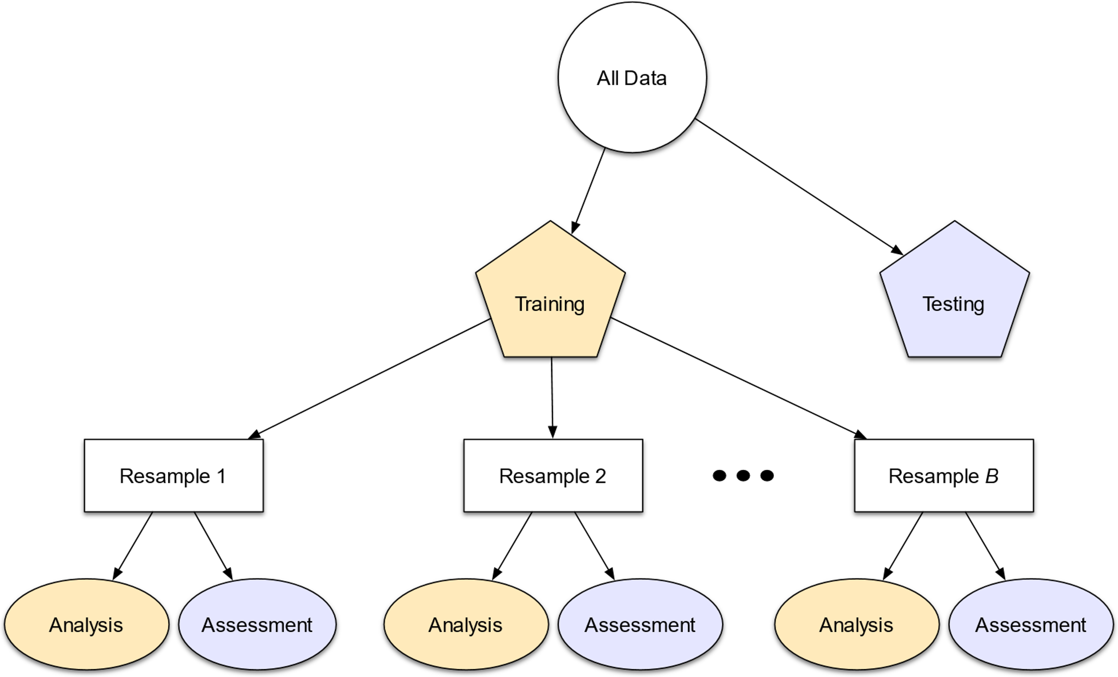
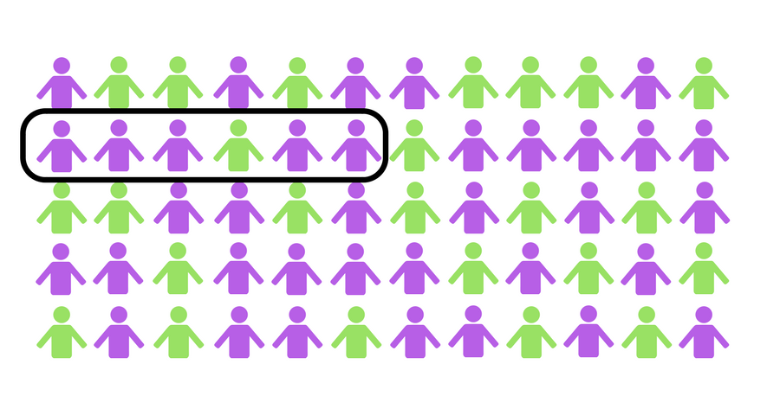
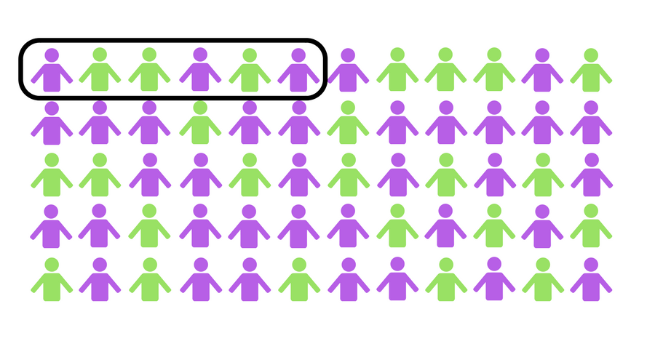
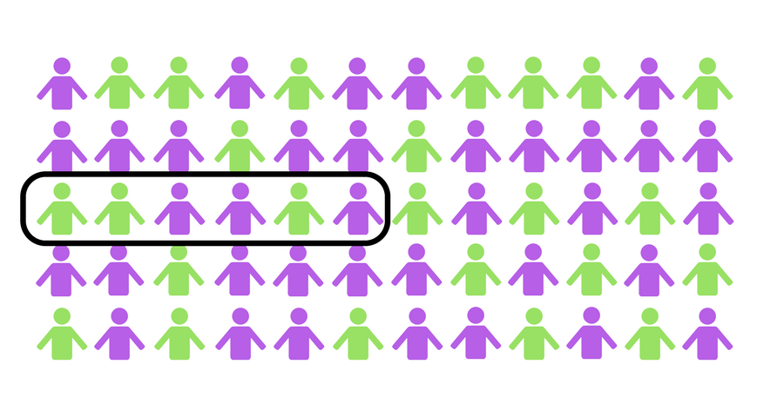
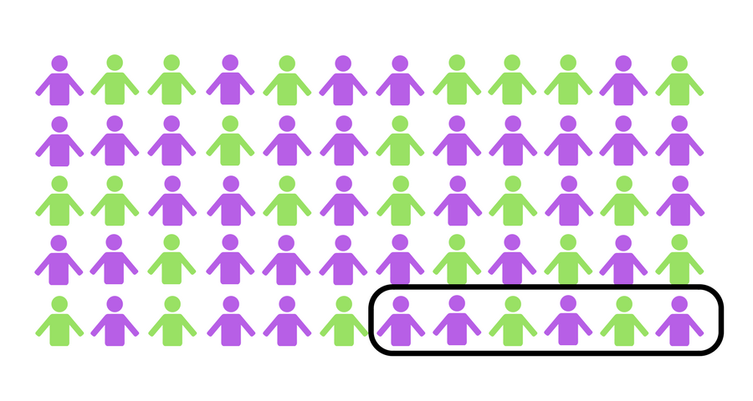
Resampling for evaluating model performance
Cross Validation
Image from Tidy Modeling with R
Image from Julia Silge's ML course

Slide 18
Knowledge Check

Slide 19
Question 2
A regression model specification was created by using the linear_reg() function in the tidymodels parsnip package. What should be done to train the model?
Call the predict() function and specify the model specification, formula, and data.
Call the recipe() function and specify the model specification, formula, and data.
Call the fit() function and specify the model specification, formula, and data.
Vote at
Vote at https://aka.ms/polls
Notes:
Explanation: Correct. After a model specification is made, model training can then be done with either the fit() function or fit_xy() function.

Slide 20
Question 3
A regression model was trained by using the tidymodels framework. When it's evaluated with test data, the model achieves an R-squared metric of 0.95. What does this metric say about the model?
The model is 95% accurate.
The model explains most of the variance between predicted and actual values.
On average, predictions are 0.95 higher than actual values.
Vote at
Vote at https://aka.ms/polls
Notes:
Explanation: Correct. The R-squared metric is a measure of how much of the variance can be explained by the model.

Slide 21
Summary
When to use regression models.
How to train and evaluate regression models by using the tidymodels framework.
Notes:
Our learning objectives for today are

Slide 22
/learn
https://aka.ms/learnlive-20220909A
Complete interactive learning exercises, watch videos, and practice and apply your new skills.
Notes:
Introduce the module

Slide 23
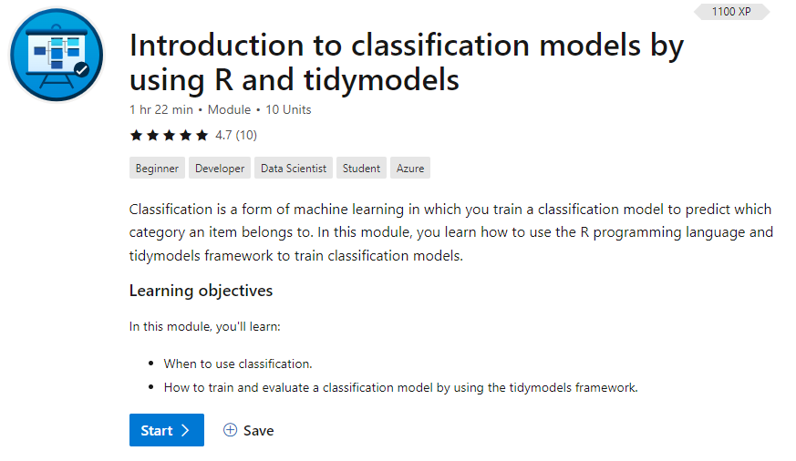
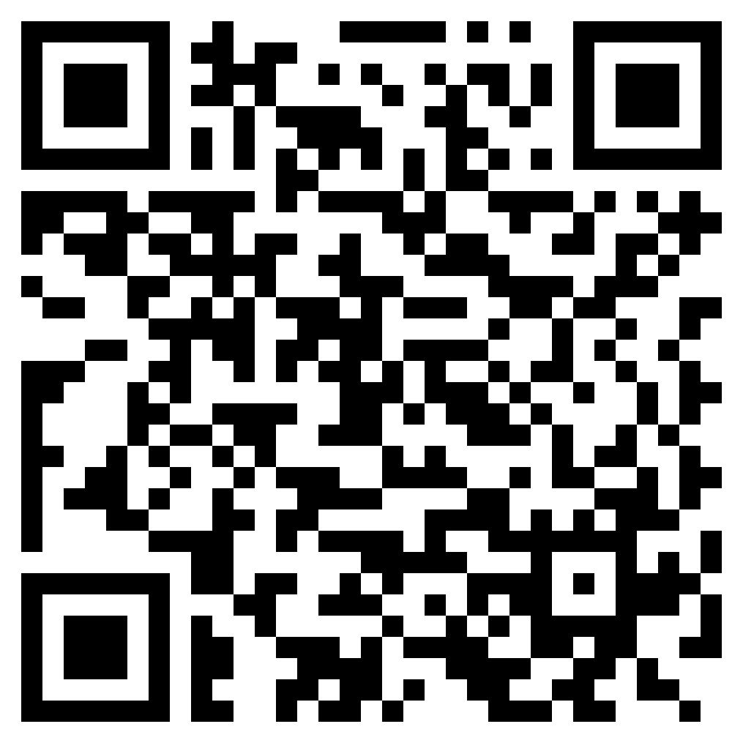
Don’t miss!
Introduction to classification models by using R and tidymodels
September 16, 2022 4:00PM - 5:30PM (Central Europe)
Continue your learning with the next module in this series!!
https://aka.ms/learnlive-machine-learning-r-tidymodels-Ep3
Notes:
This is a series of 4 episodes, don’t miss the next one!

